Slide 1
Matrix Approach to Linear Regression

Slide 2
The Model in Scalar Form
Y_{i} = β₀ + β₁X_{i}
Consider writing the observations:
Y₁= β₀ + β₁X₁
Y₂= β₀ + β₁X₂
:
Y_{n}= β₀ + β₁X_{n}

Slide 3
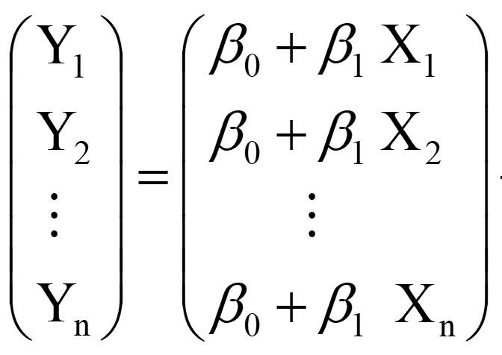
The Model in Matrix Form

Slide 4
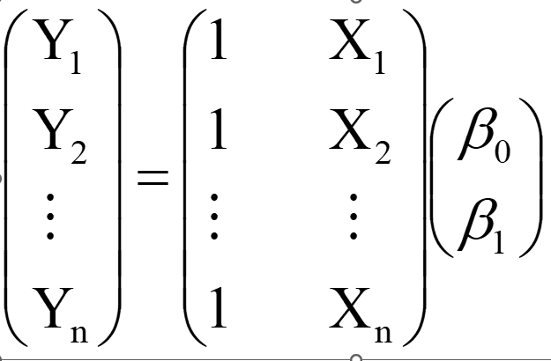
The Model in Matrix Form II

Slide 5
The Design Matrix

Slide 6
Vector of Parameters

Slide 7
Vector of responses

Slide 8
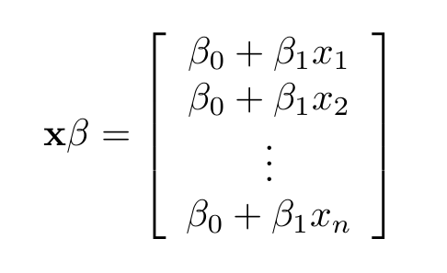

Slide 9

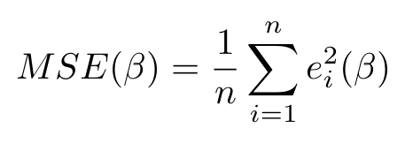
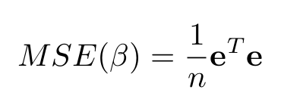
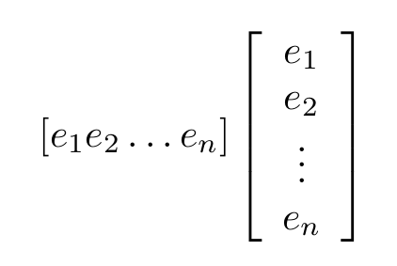
Least Squares: Mean Squared Error

Slide 10




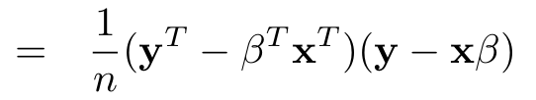
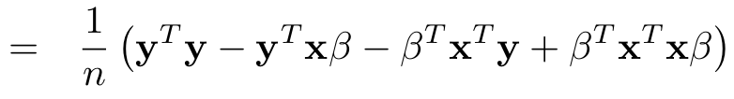

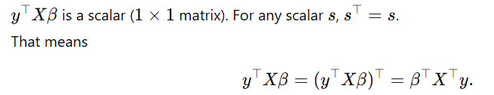


Slide 11
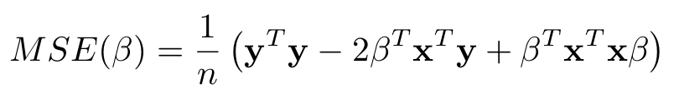
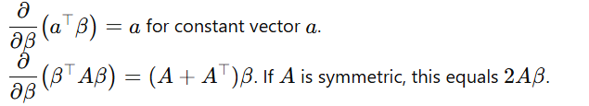
Compute the gradient (matrix derivative)

Slide 12
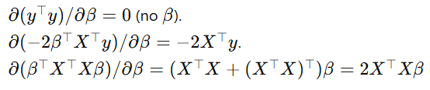
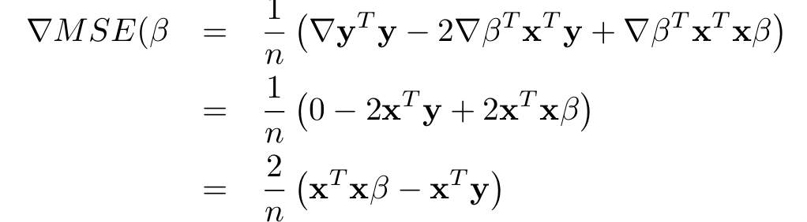

Slide 13
